Slide 1
Technology Hackathon - 2025
Challenge : Gen AI-Orchestrator for Email and Document Triage/Routing
Team Name : Dangal
Gangireddy, Madan Mohan Reddy
Srivastava, Sakshi
Yalla, Tanuja
Gangoni, Rajendhar
Undapalli SVVSV Prasanna U
Date : 26th Mar 2025

Slide 2
Email and Document Triage/Routing
Problem Statement: Incoming Service Requests via Email require Manual Triage, Where a “gatekeeper” Who:
Reads and interprets the emails content and attachments
Identify the Intent of the email and classify the “Request Type” and “Sub Request Type”
Extract key attributes for populating in service requests.
The challenge is to Automate email classification and data extraction using Generative AI(LLMs).

Slide 3
Email and Document Triage/Routing
Strategy:
Understand Problem Statement
Synthetic Data Preparation to collect .eml files and request/sub-Request Types
Data Processing and Feature extraction
Model Selection
Zero-shot Classification
Model Evaluation and Optimization
Deployment and Integration

Slide 4
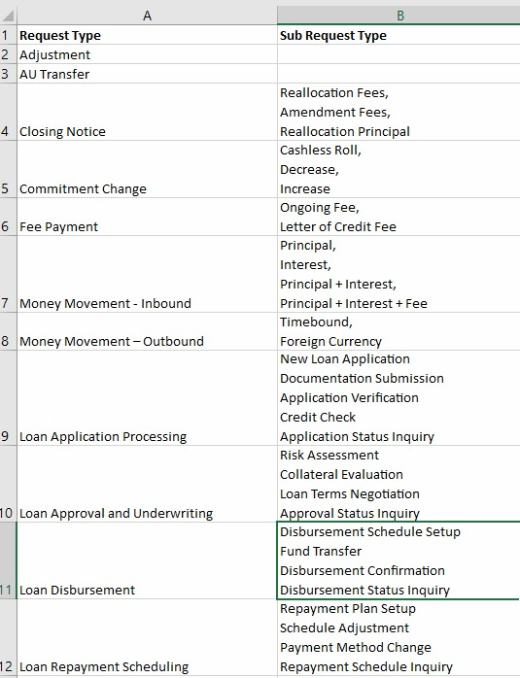
Email and Document Triage/Routing
Sample Data:
Gather Request Type and Sub Request Type list appropriate to the use case
Prepare .eml files with attachments .pdf and .jpg etc using gpt 4.0 with a prompt

Slide 5
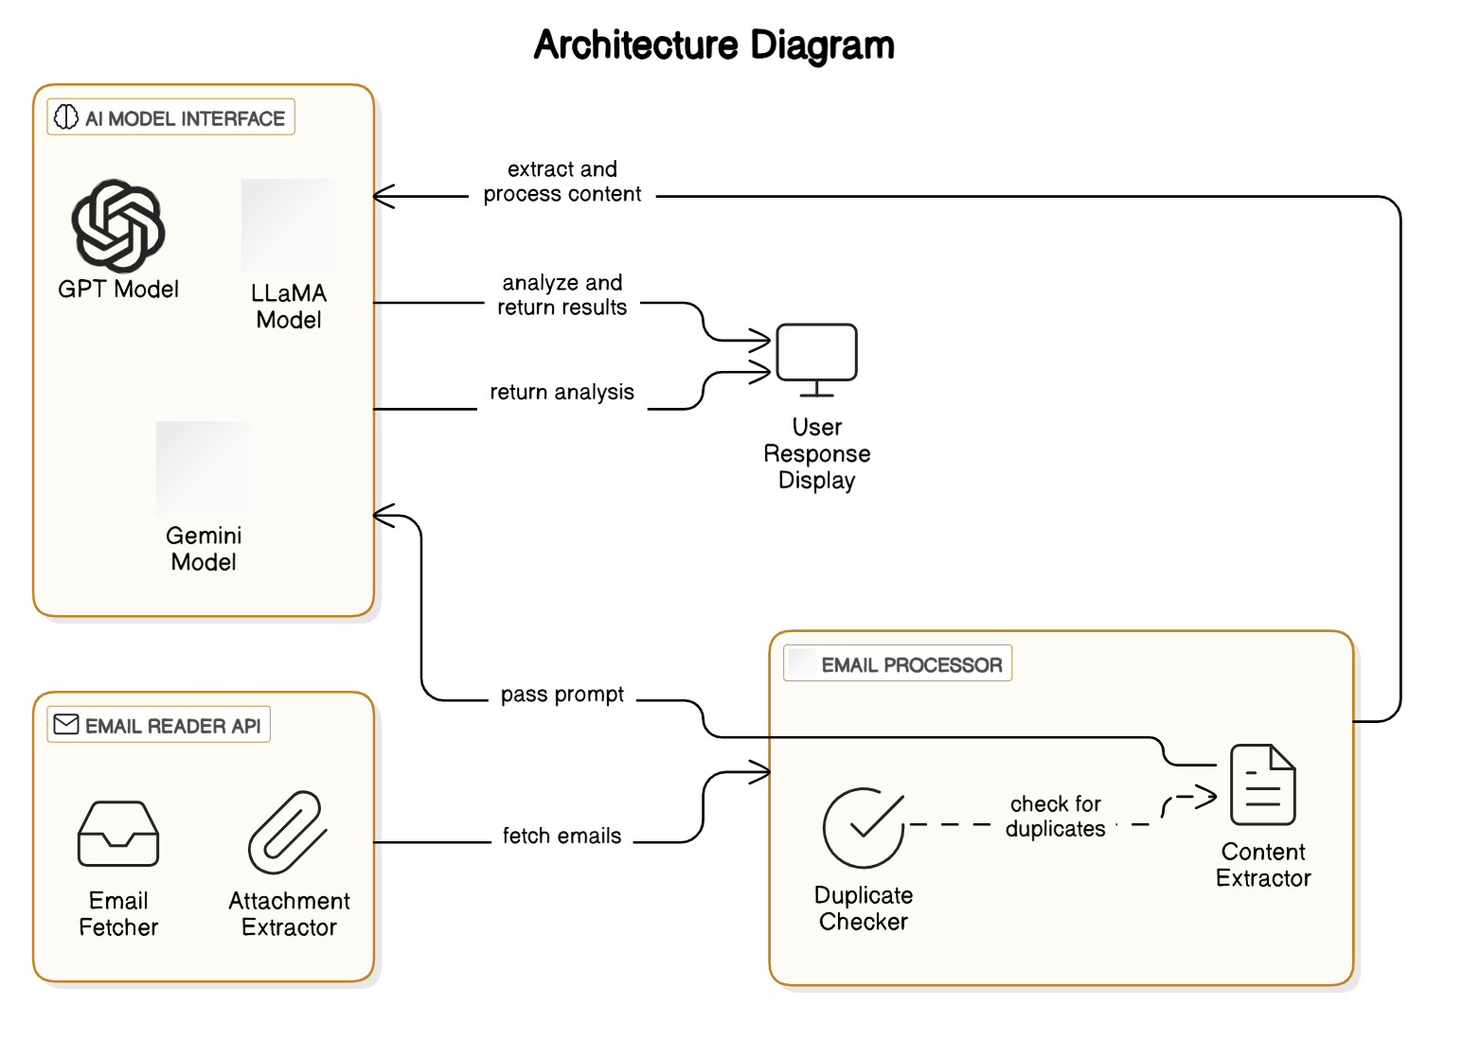
Email and Document Triage/Routing

Slide 6
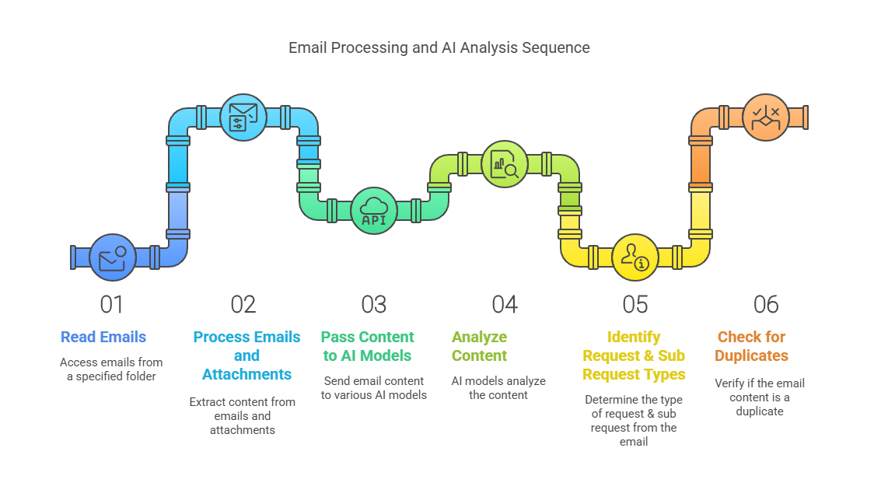
Email and Document Triage/Routing

Slide 7
Technology Stack
Email and Document Triage/Routing
Back End - Fast API & UVICon
LLMs - LlaMA, GPT, Gemini
Python Libraries - PyMuPDF, docx, pytesseract, Image, BytesParser, policy
Front End - React and Node.js
Test Automation - Pytest

Slide 8
Email and Document Triage/Routing
Future Scope:
Integrate with OpenRouter is a platform that provides a unified interface for integrating multiple large language models (LLMs).
Testing pre-trained models with more data.
It can be extended to any other Domain as inputs/categories are configurable and interactive.

Slide 9
Email and Document Triage/Routing
DEMO

Slide 10
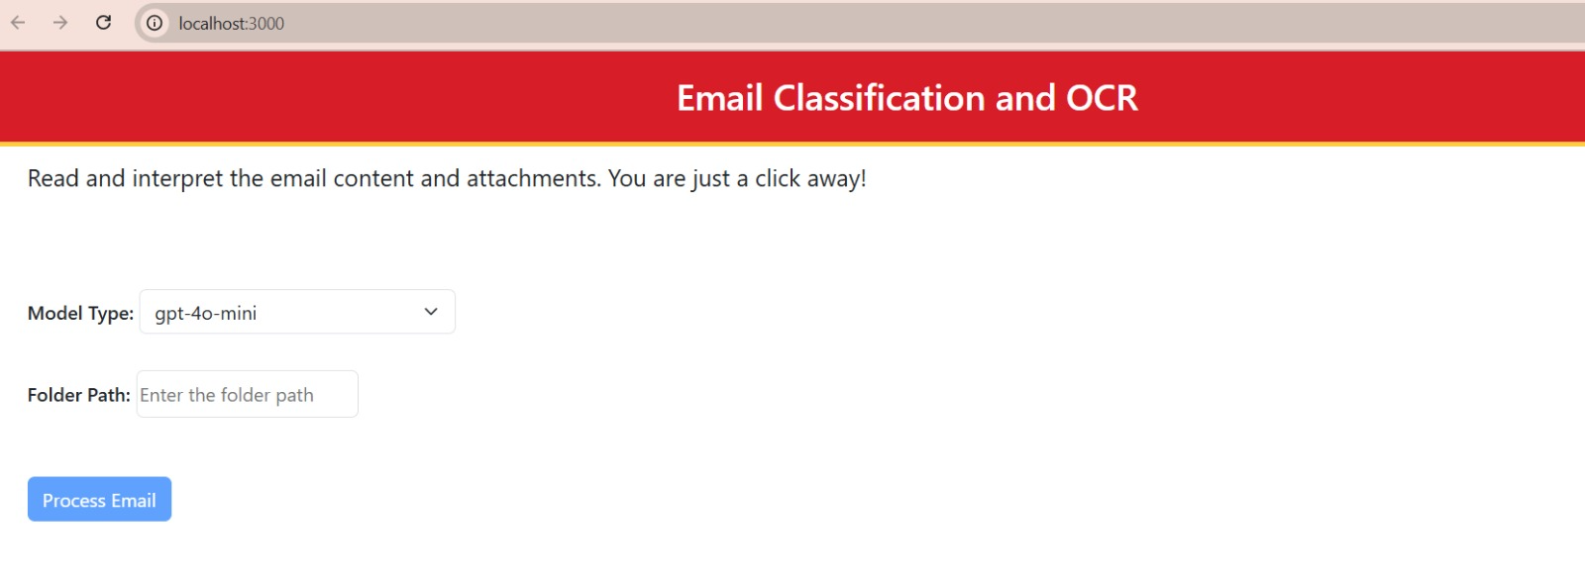
Email and Document Triage/Routing
UI Screenshots:

Slide 11
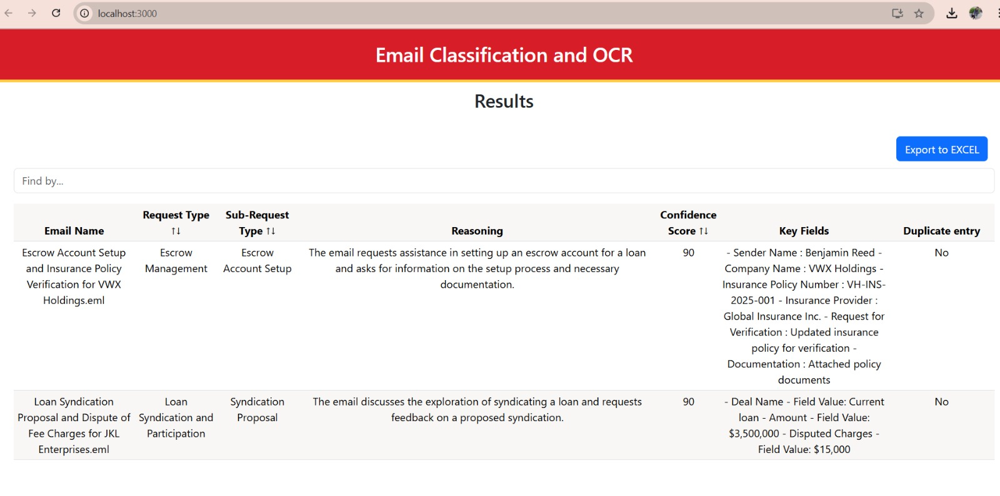
Email and Document Triage/Routing
Results Screenshots:

Slide 12
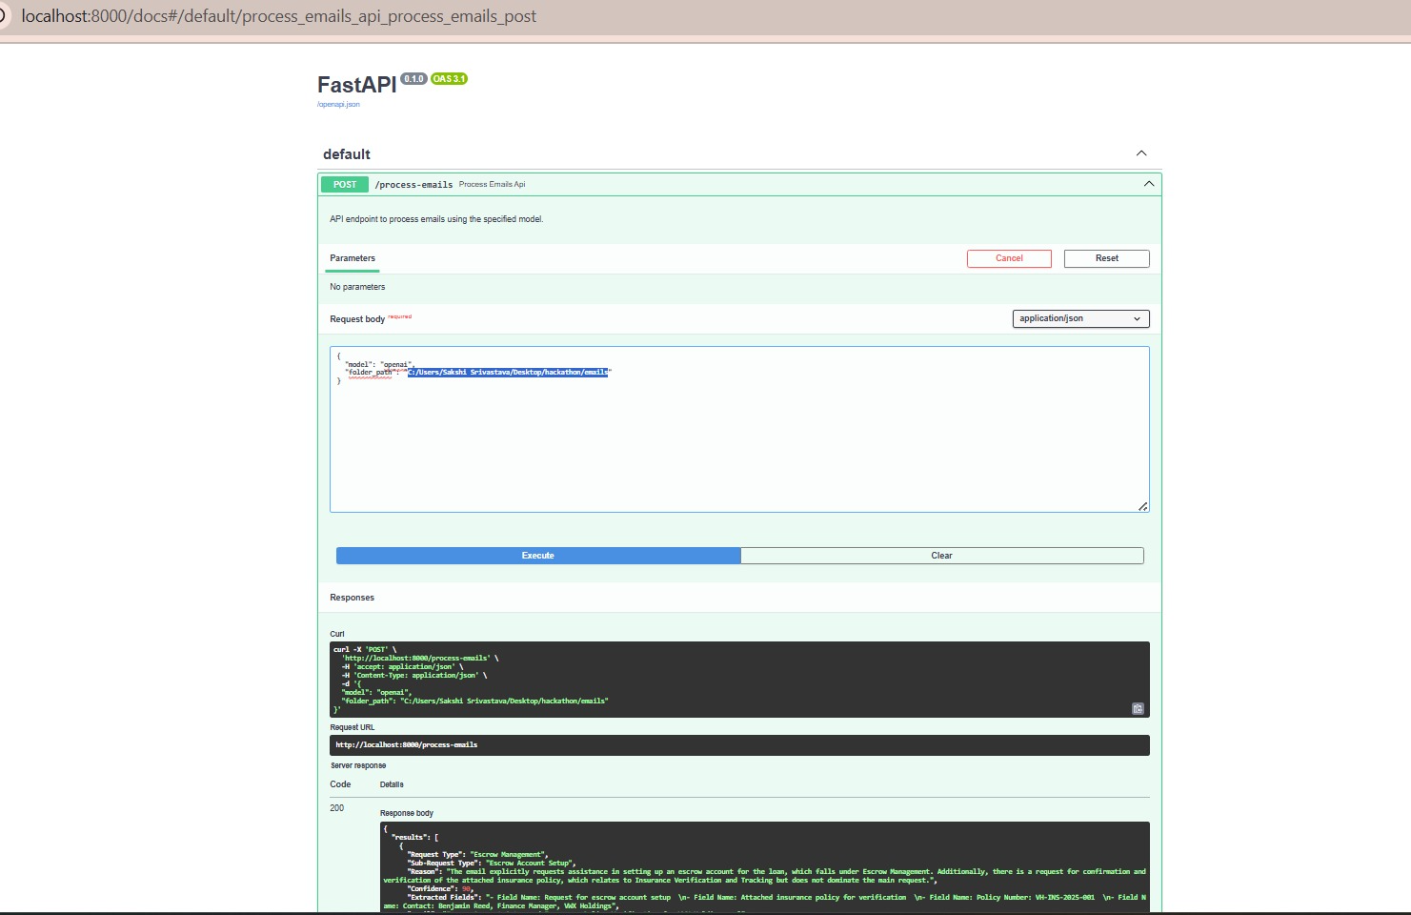
Email and Document Triage/Routing
API Screenshots:

Slide 13
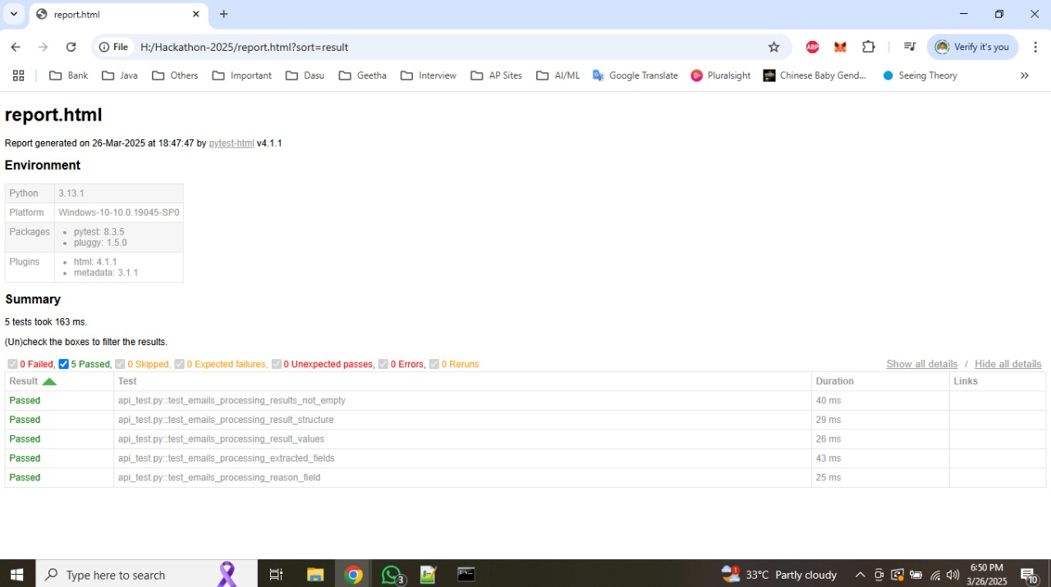
Email and Document Triage/Routing
Testing Screenshots:

Slide 14
Thank You !!!
Q&A

